Slide 1
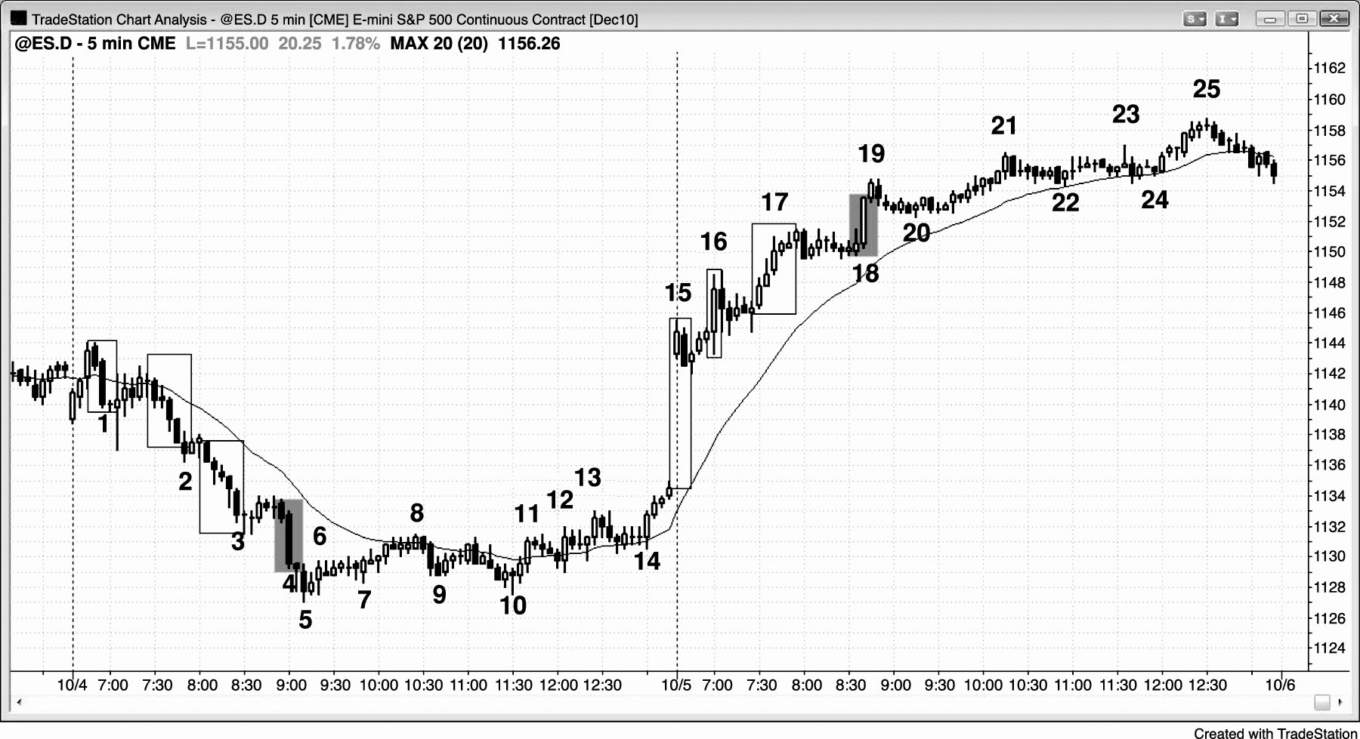
FIGURE 5.1 A Late Breakout in a Trend Can Lead to Reversal or a New Leg

Slide 2
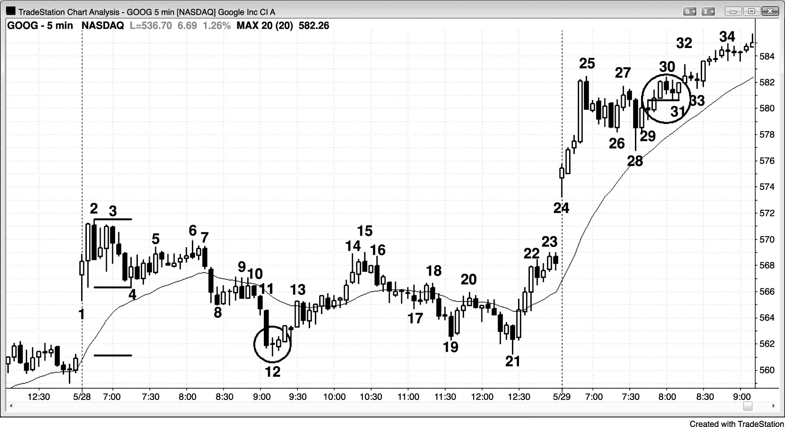
FIGURE 5.2 Breakout Pullbacks

Slide 3
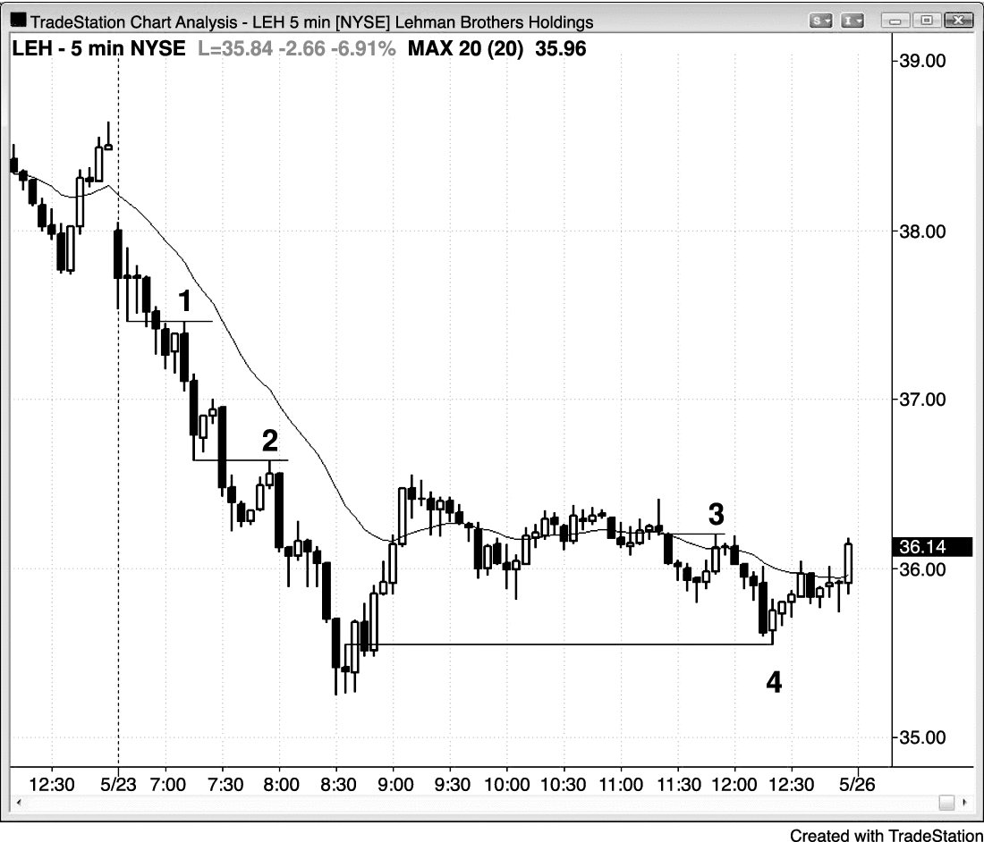
FIGURE 5.3 Breakout Tests

Slide 4
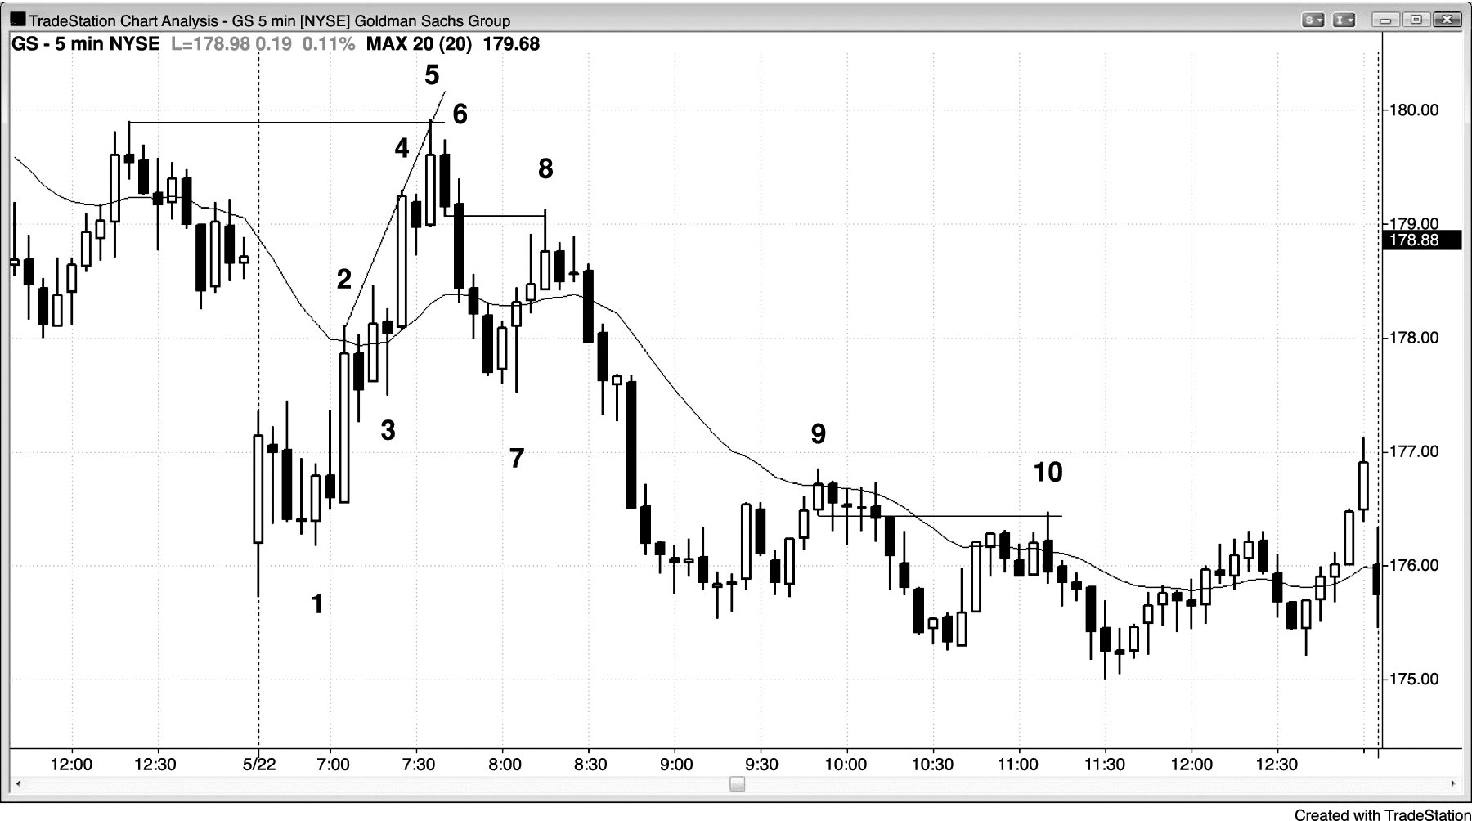
FIGURE 5.4 Breakout Tests Can Hit Breakeven Stops

Slide 5
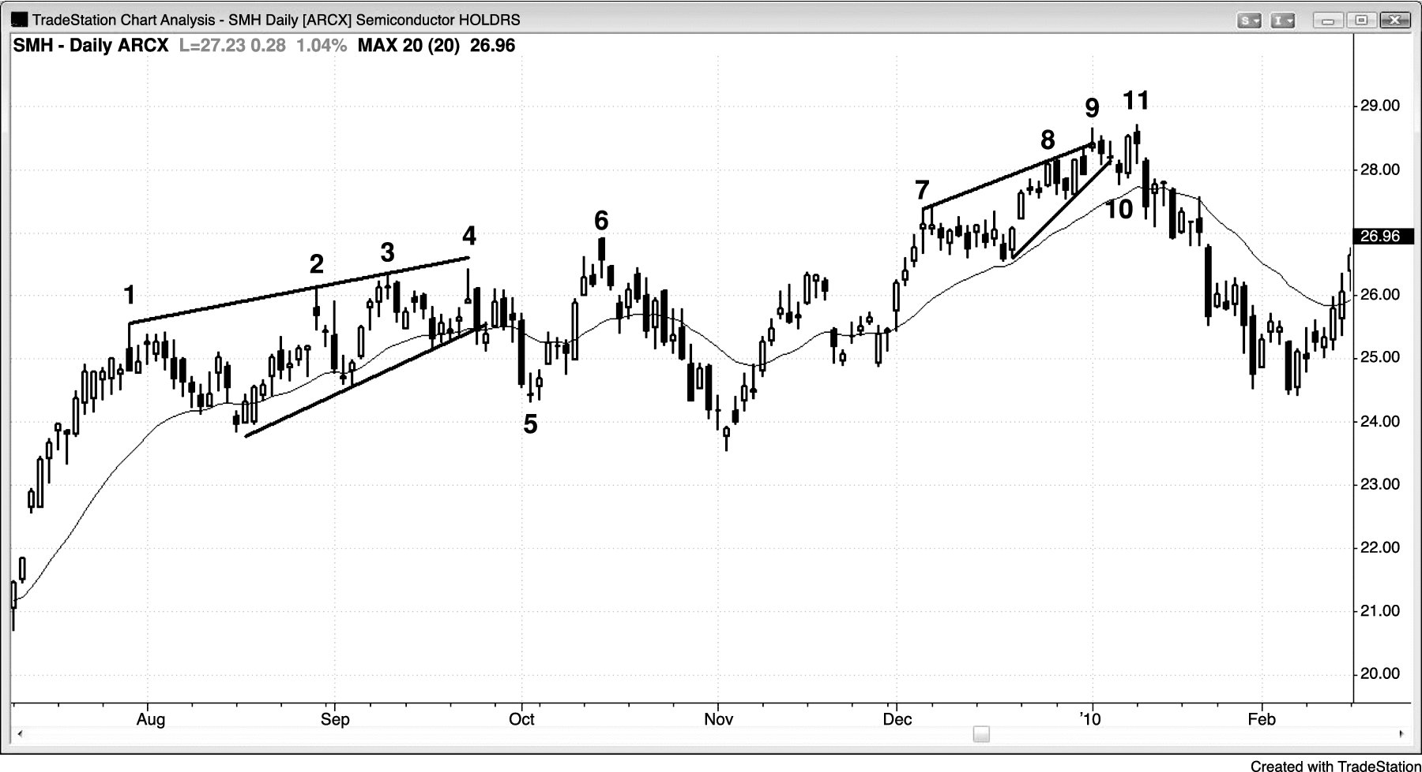
FIGURE 5.5 A Breakout Pullback at a Top Can Be a Higher High

Slide 6
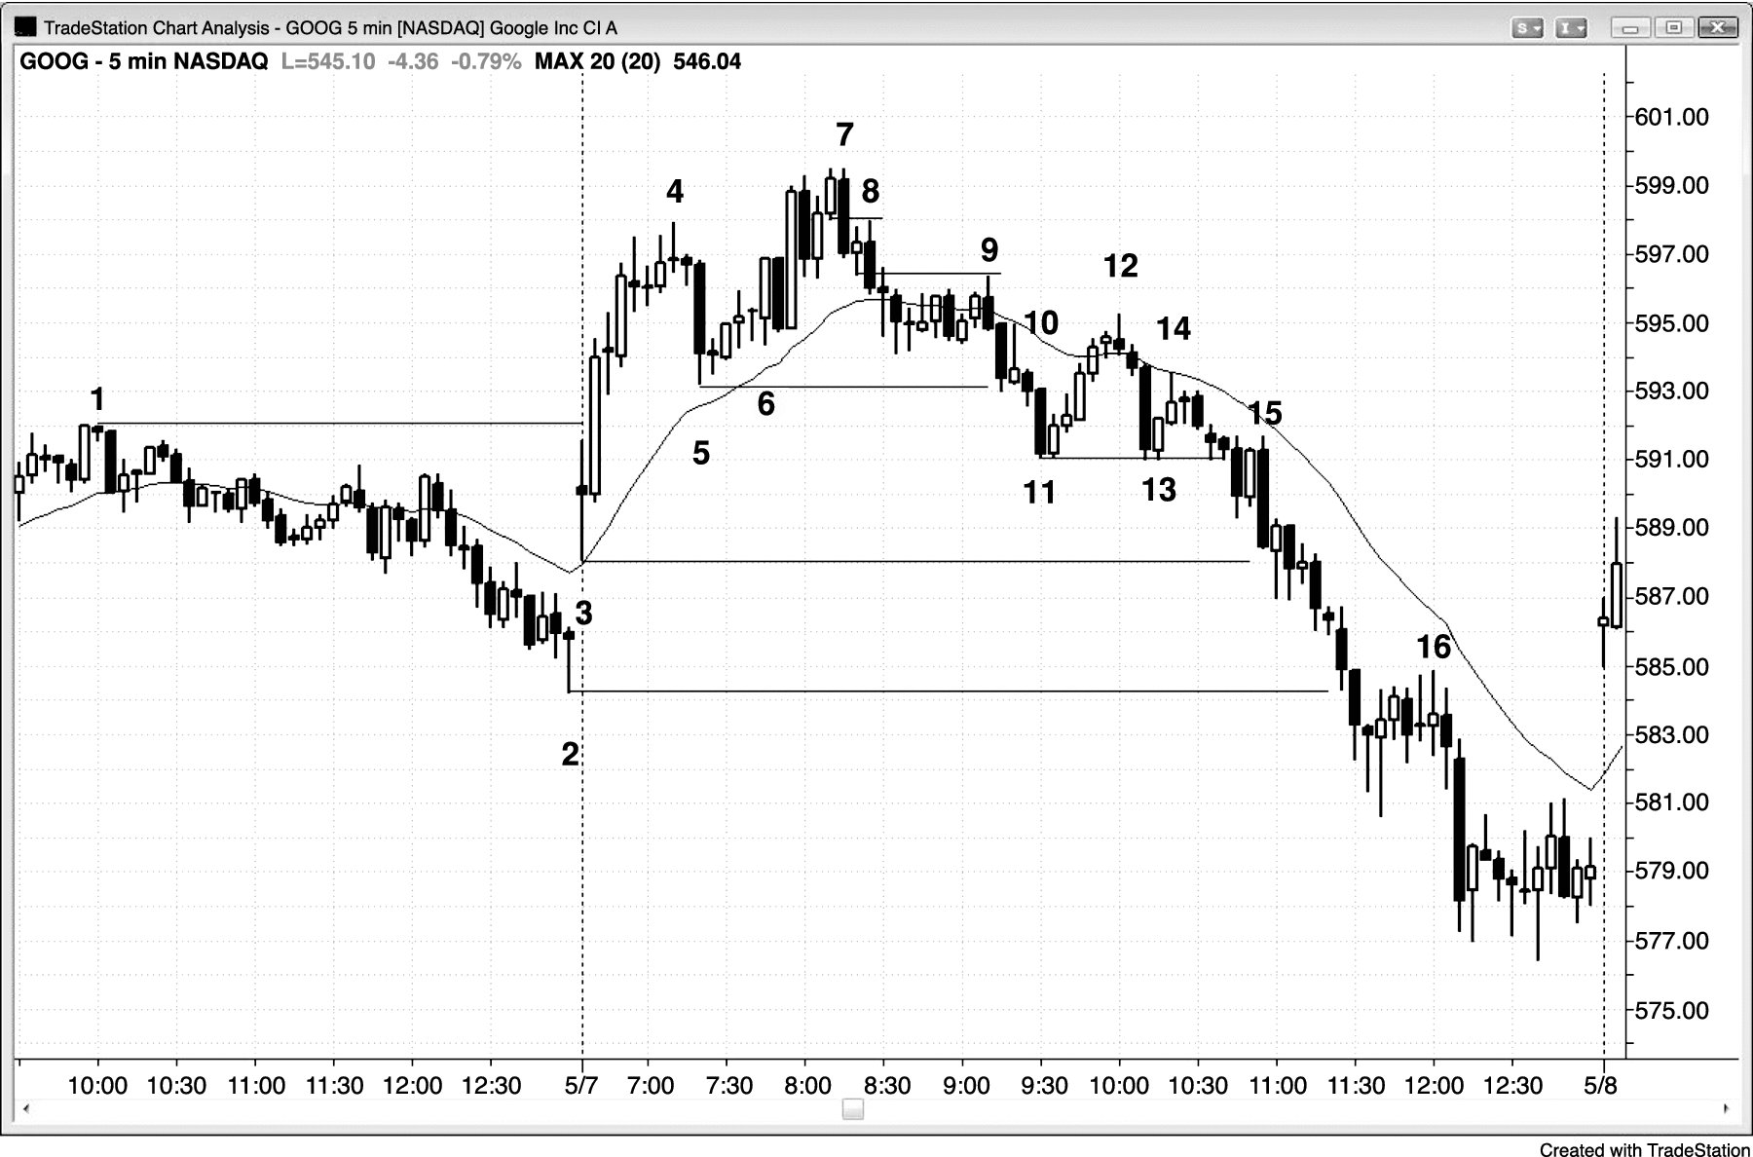
FIGURE 5.6 Breakout Pullback Setups

Slide 7
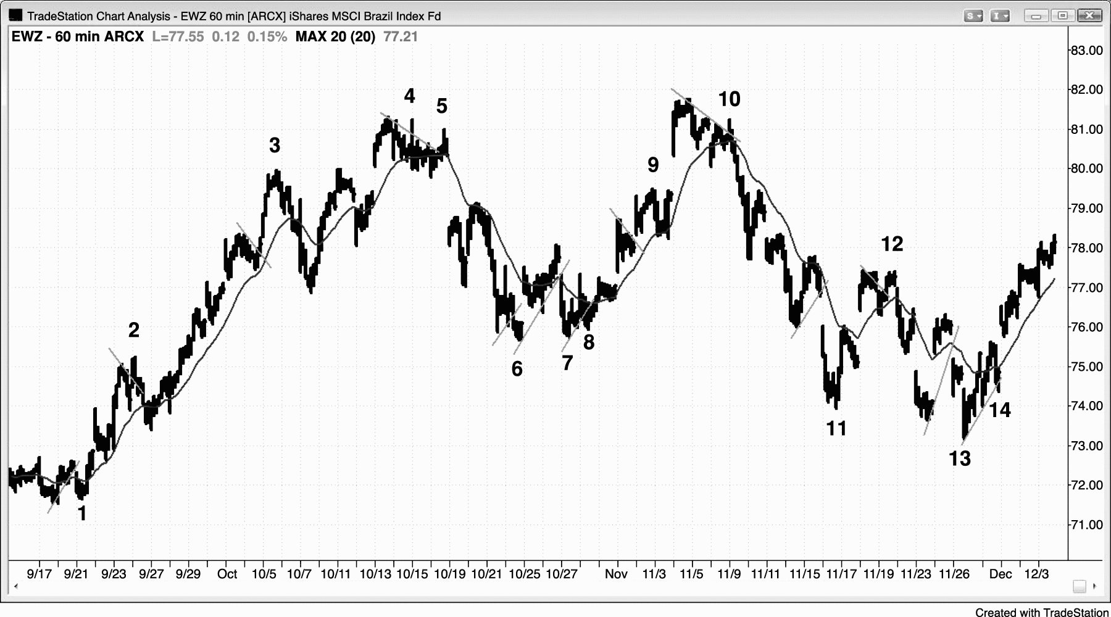
FIGURE 5.7 Failed Breakouts

Slide 8
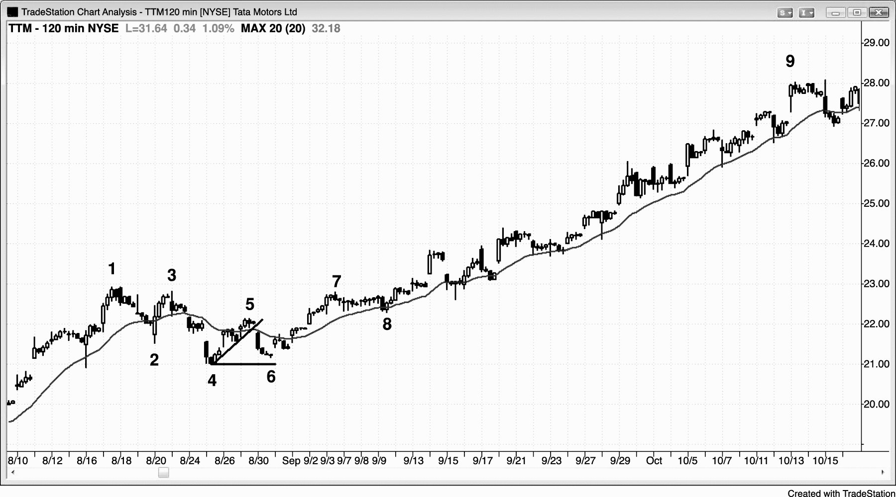
FIGURE 5.8 Final Flag

Slide 9
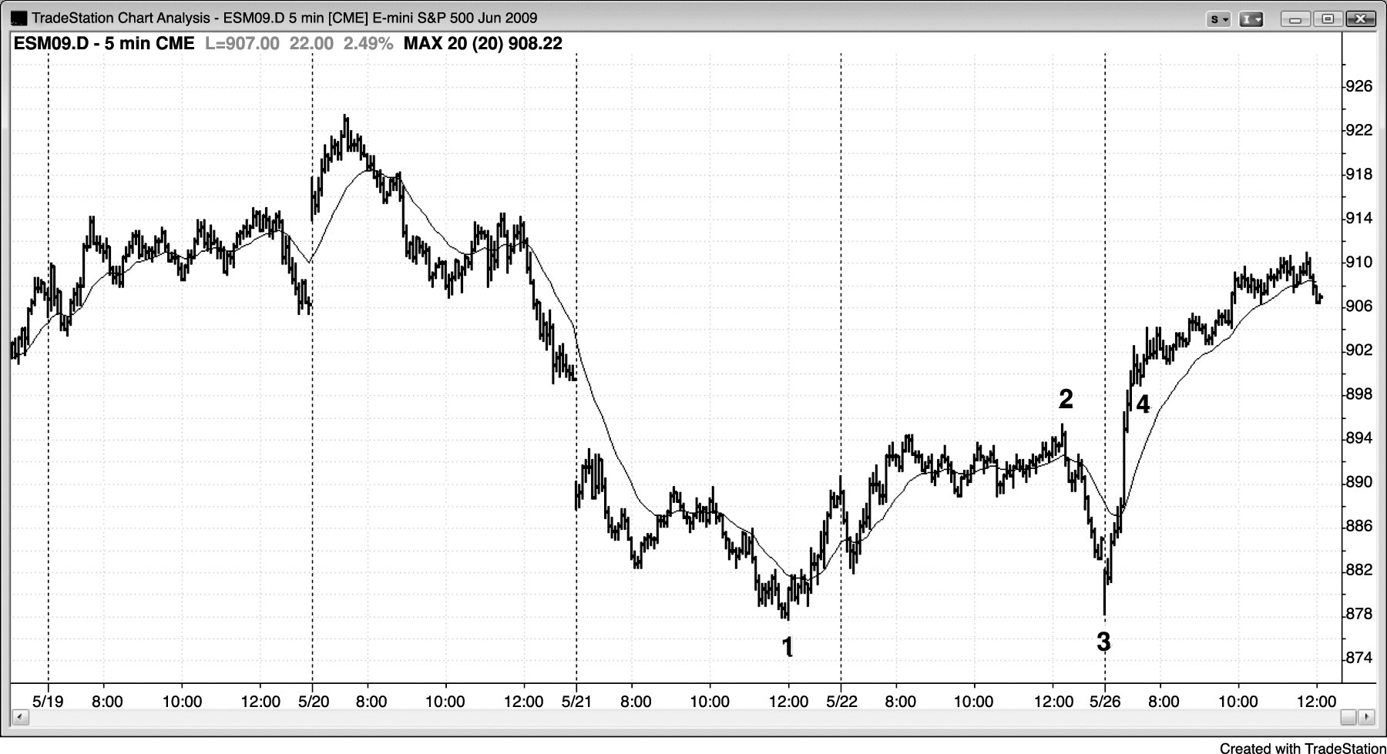
FIGURE 5.9 Double Bottom

Slide 10
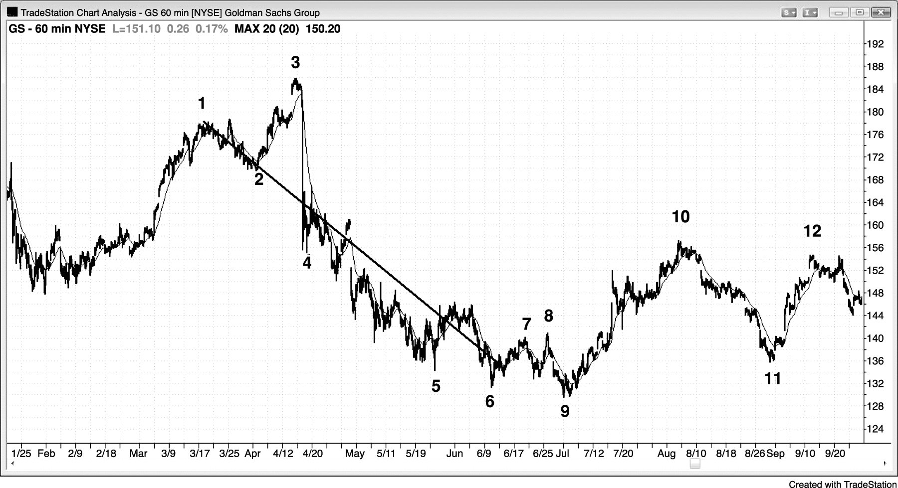
FIGURE 5.10 The Final Flag Slope Can Predict Slope of New Trend

